Slide 1
MD RoboticS 2016-2017
Control System
August 2016

Slide 2

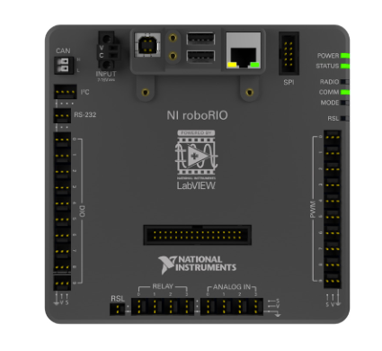

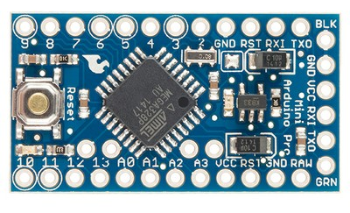




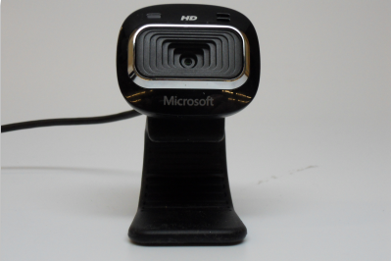
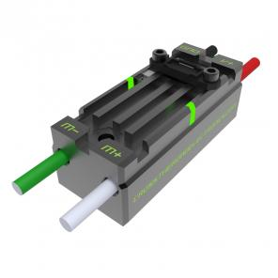
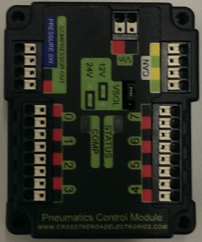
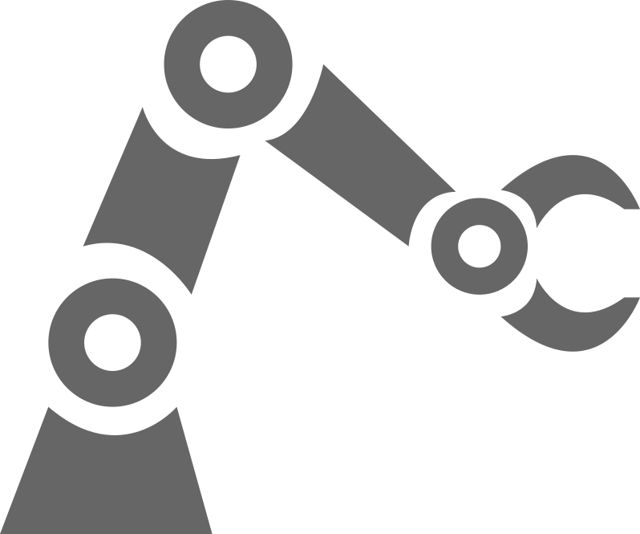

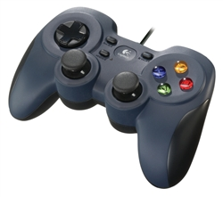
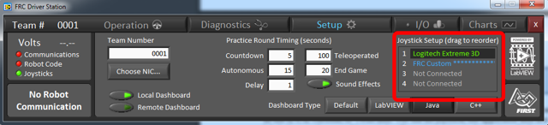
What is the control System?
RoboRio / Arduino
Java / C
Sensors
Telemetry (gyro, switch)
Camera
Actuators
Motors
Pneumatics
Operator Interface
Joystick
Driver Station
Console
Documented at https://wpilib.screenstepslive.com/s/4485

Slide 3
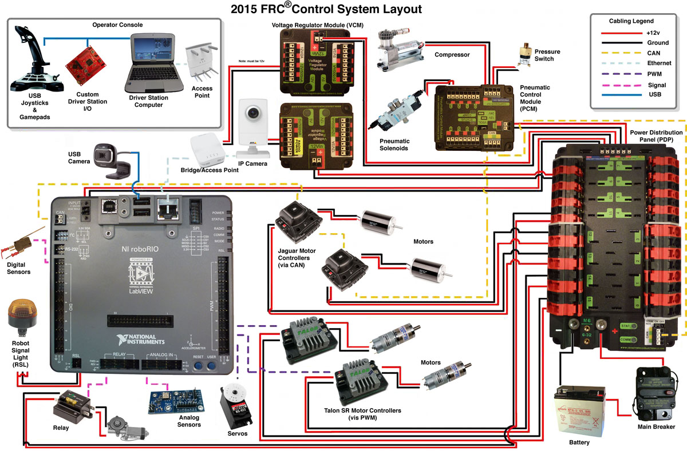
Source: Team 358: http://www.team358.org/files/programming/ControlSystem2015-2019/

Slide 4









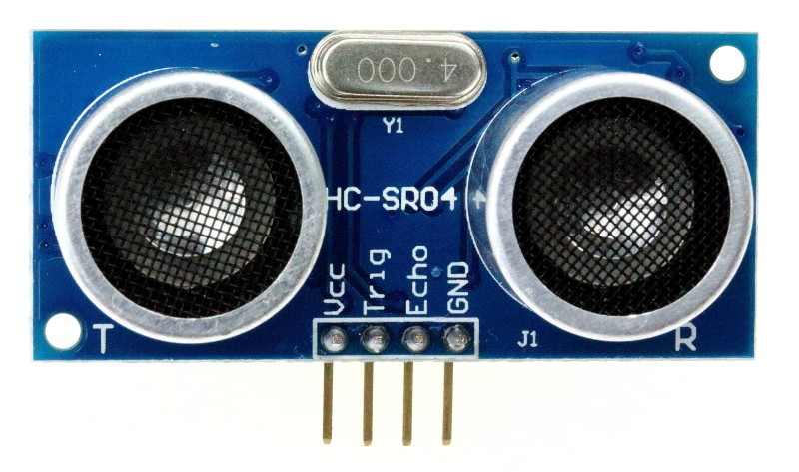
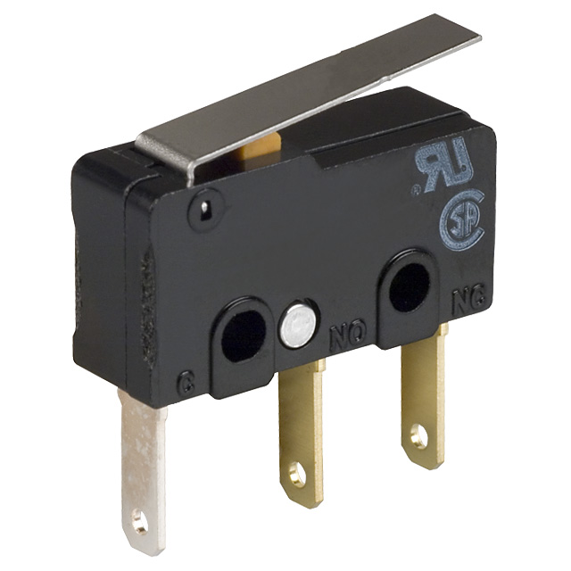
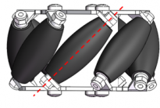




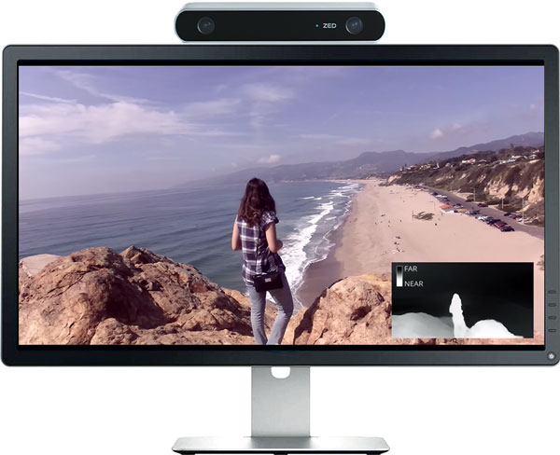



Accomplishments To Date
How do we keep moving the dial?
30th
Accomplishments
11th
2015
2016
2017
2018
Missed Opportunities

Slide 5


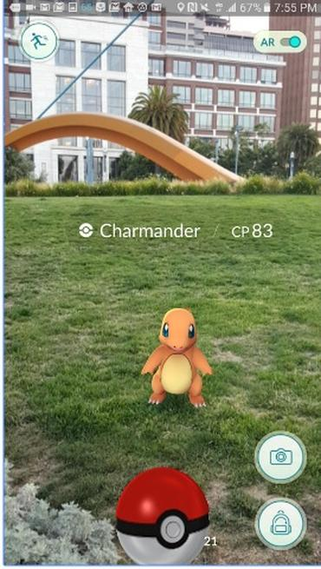
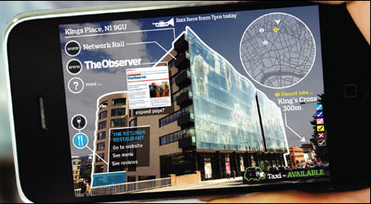
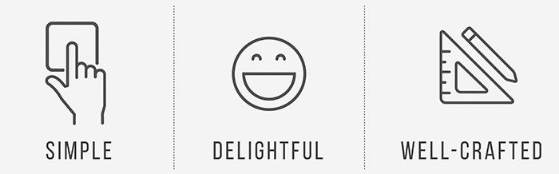
Software Development Opportunities
Embedded Computing
UX / Human Interface
Robot Vision
Autonomous operation
Robot logic
Telemetry
PID controllers
Talon SRX
State machines
Complex commands
Multi-threaded concurrent operations
Scheduler
Robot configuration
Improved driving control
Adapt tote driving system
Gyroscope and accelerometer enhanced navigation
Simulation environment
Enable faster development
Version control
Reuse of components from prior years
Enhanced Driver station
More useful robot to driver feedback
Visualization through HTML5/Angular/JavaScript
Adaptive console
Support for more complex interface controls
Improved robot configuration
Real-time robot communications via Websockets
Video Streaming
Compressed video streaming compatible with 7mbps bandwidth limitation
Video / Image processing
Pattern recognition
Augmented Reality
Target acquisition & tracking
Goal
boulder
Score confirmation
Navigational assistance
Autonomous mode assistance
Embedded co-processors

Slide 6

Opportunities – Embedded Systems
Mastering Talon SRX
Motor speed controller with embedded feedback
Make more use of advance Robot features
PID
Command Scheduling
RoboRio Connector shield (RJ45?) for sensors
LIDAR
Better instrumentation
Improve Arduino capability
Robot Simulation
Ideal for someone who wants
Learn Java
Learn how to control a robot
Learn about control systems
Learn advanced network technologies like WebSockets & DNS-SD
Learn how to do things with Arduino
Wish List Item
LIDAR
WIRING CONNECTOR KIT

Slide 7
Opportunities – UI/UX
Improve / mature MDConsole features
Make easier to use
Make more intuitive
Add Analytics / Visualization
Make console adaptive / situational behavior
Embed video streaming viewer
Improve Robot configuration
RoboRio and Arduinos
Database retrieve and selective rerun recorded sessions
Competition Checklist tab
Scouting app
Ideal for someone who wants
Learn JavaScript
Learn modern web development like Angular, Material Design, NoSQL
Develop UX Design skills
Learn advanced network technologies like WebSockets & DNS-SD (Bonjour)
Wish List Item
Large touch screen

Slide 8
Opportunities – Robot Vision
Implement basic robot vision
Object discovery
Object tracking
WebCam & Stereoscopic
WebSocket event exchange with RoboRio and MDConsole
High performance real-time video streaming for operator assist
Simple augmented reality
Ideal for someone who wants
Learn robot vision algorithms
Object identification
Object tracking
Learn about video streaming
Learn GPU programming
Learn C++ & Java
Wish List Item
NVidia Jetson TX1
Automobile Backup
Camera module
IP streaming camera

Slide 9
Opportunities – Team Improvements
Knowledge base
How To Guides to on board team members
Capture knowledge already learned
Articles explaining complex pieces
Version control
Ideal for someone who wants
To be a leader
To build a strong team
To improve year over year
To compete at the national level
Wish List Item
Student mentors
Year Round Commitment

